Slide 1
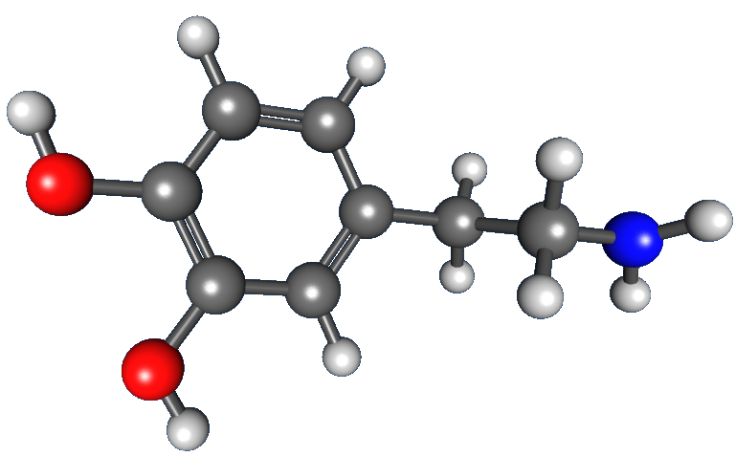
Dopamine
Key Aspects

Slide 2
Dopamine – Key Aspects
What is?
How?
xxx
Why?
“There is no reliable way to directly measure levels of dopamine in a person’s brain.
There are some indirect ways to determine a dopamine level imbalance in the brain. Doctors can measure the density of dopamine transporters that correlate positively with nerve cells that use dopamine. This test involves injecting a radioactive material that binds to dopamine transporters, which doctors can measure using a camera.
A doctor will look at a person’s symptoms, lifestyle factors, and medical history to determine if they have a condition related to low levels of dopamine.”
Project
Video: https://www.youtube.com/watch?v=dqFXR3Cc0G8&feature=youtu.be
https://www.medicalnewstoday.com/articles/320637#outlook

Slide 3
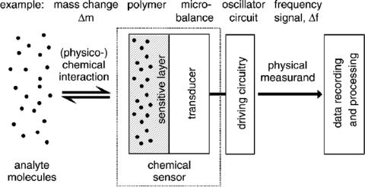
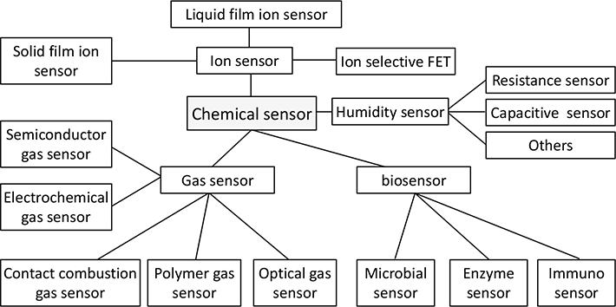
Dopamine – Chemical Sensoring
Examples:
Breathalyzer: measure a person's blood alcohol content (BAC)
https://www.fierceelectronics.com/electronics/what-a-chemical-sensor
https://www.intechopen.com/books/progresses-in-chemical-sensor/introductory-chapter-what-is-chemical-sensor-
http://nano-bio.ehu.es/files/chemical_sensors1.doc_definitivo.pdf

Slide 4
Dopamine - Brain Health Analysis
The Brain health can be measured based on events that lead to a rapid need for oxygen and glucose from the vascular system:
Cerebral metabolic rate for glucose (CMRglc) → Positron emission tomography (PET)
Blood-oxygen-level dependent (BOLD) signal → Functional magnetic resonance imaging (fMRI)
Energy expenditure mapping (pre, during and post synaptic neuronal signaling)

Slide 5
Dopamine - most precise methods of measuring dopamine levels
HPLC or Mass spec for lysates
Radiactive
Imaging
biomarkers measured from eccrine sweat
https://www.researchgate.net/post/Which_are_the_most_precise_methods_of_measuring_dopamine_levels_in_different_parts_of_the_rat_brain
https://www.nature.com/articles/s41746-019-0150-9

Slide 6
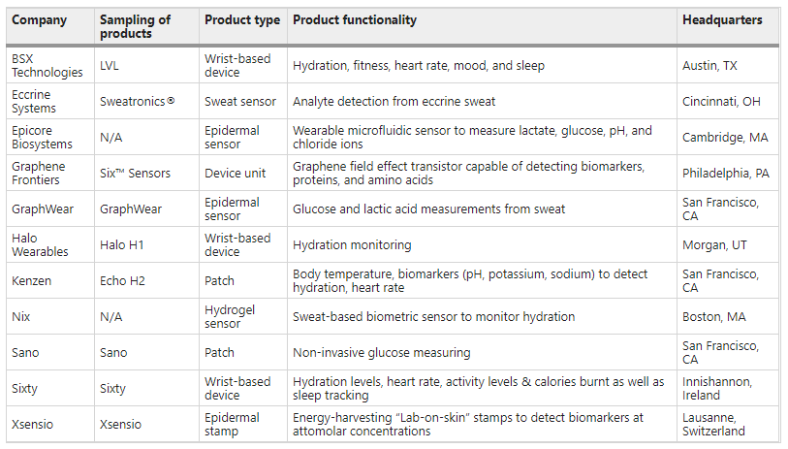
biomarkers from eccrine sweat or saliva
Wearable technology companies with products applicable towards measuring biomarkers from eccrine sweat or saliva
https://www.nature.com/articles/s41746-019-0150-9/tables/1

Slide 7
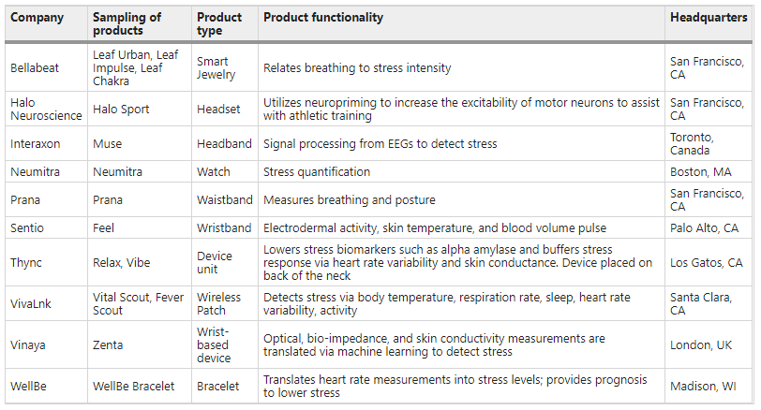
mental acuity and stress measuring
Wearable technology companies with products applicable toward measuring the mental acuity and stress of the athlete
https://www.nature.com/articles/s41746-019-0150-9/tables/2

Slide 8
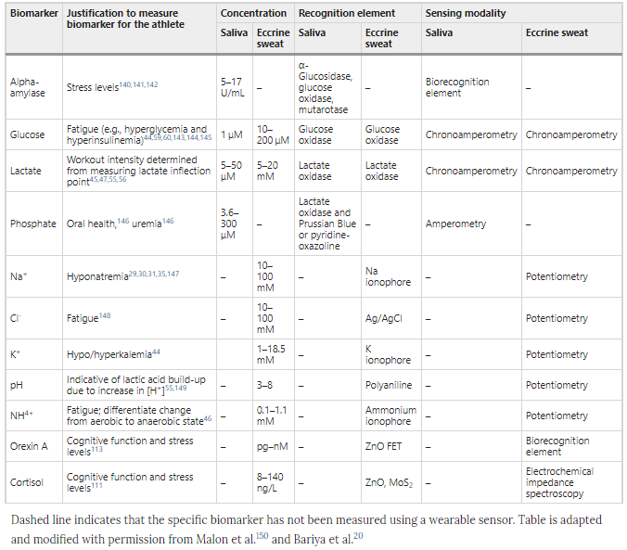
noninvasive saliva and eccrine sweat sensors
Sampling of biomarkers or physiological parameters which have been measured noninvasively from saliva and eccrine sweat sensors for monitoring human performance
Dashed line indicates that the specific biomarker has not been measured using a wearable sensor. Table is adapted and modified with permission from Malon et al.¹⁵⁰ and Bariya et al.²⁰
https://www.nature.com/articles/s41746-019-0150-9/tables/4

Slide 9
Dopamine – Proposed method for dopamine levels measurement
Correlation of:
Gsr (Galvanic Skin response)
Bpm (Heartbeats per minute)
SpO2 (oxygen saturation, an estimate of the amount of oxygen in the blood)
Physical activity
Pearson's Correlation Coefficient
To measure biomarkers from sweat must adhere to the following set of requirements:
(1) the sweat analyte must be correlated to those found in blood circulation,
(2) the sweat rate must be steady or measured as a result of analyte dilution or sensor-dependencies on sweat rate,
(3) sweat must be transported and coupled to sensors in an expeditious manner to minimize analyte exchange with the skin or transport materials themselves, and
(4) continuous raw data needs to be shown for the measured analyte in both sweat and blood to ensure that various confounding factors have been resolved (e.g., influence of changing pH or salinity, sensor reversibility, or body motion artifacts)
http://learntech.uwe.ac.uk/da/default.aspx?pageid=1442
https://www.nature.com/articles/s41746-019-0150-9

Slide 10
Dopamine – Project Risk map
Ethic and segment rules
● Tests involving humans (eg “ExAmp- 20K can be used for research and teaching purposes only that do not involve human subjects.”)

Slide 11
Dopamine – Professionals References
Eliseo A Eugenin
Ph.D. in Physiology
University of Texas Medical Branch at Galveston
UTMB · Department of Neuroscience and Cell Biology
Site: https://www.researchgate.net/profile/Eliseo_Eugenin
Denes Budai
Ph.D.
Kation Scientific LLC
Site: https://www.researchgate.net/profile/Denes_Budai

Slide 12
Dopamine - Literature
Parkinson
Optical deconstruction of parkinsonian neural circuitry (https://www.ncbi.nlm.nih.gov/pubmed?Db=pubmed&Cmd=ShowDetailView&TermToSearch=19299587)
Dopamine studies
Dopamine receptors: from structure to function (https://www.ncbi.nlm.nih.gov/pubmed?Db=pubmed&Cmd=ShowDetailView&TermToSearch=9457173)
Afferent modulation of dopamine neuron firing patterns (https://www.ncbi.nlm.nih.gov/pubmed?Db=pubmed&Cmd=ShowDetailView&TermToSearch=10607649)
Evidence for striatal dopamine release during a video game →
https://www.ncbi.nlm.nih.gov/pubmed?Db=pubmed&Cmd=ShowDetailView&TermToSearch=9607763
Absolute abundances and affinity states of dopamine receptors in mammalian brain: A review (https://www.ncbi.nlm.nih.gov/pubmed?Db=pubmed&Cmd=ShowDetailView&TermToSearch=21308799)
Predictive reward signal of dopamine neurons (https://www.ncbi.nlm.nih.gov/pubmed?Db=pubmed&Cmd=ShowDetailView&TermToSearch=9658025)
Monitoring Dopamine in Vivo, human brain
Imaging dopamine neurotransmission in live human brain (https://www.ncbi.nlm.nih.gov/pubmed?Db=pubmed&Cmd=ShowDetailView&TermToSearch=24968780)
Simultaneous electrochemical measurements of oxygen and dopamine in vivo (https://www.ncbi.nlm.nih.gov/pubmed?Db=pubmed&Cmd=ShowDetailView&TermToSearch=1810167)
Glial and neuronal control of brain blood flow (https://www.ncbi.nlm.nih.gov/pubmed?Db=pubmed&Cmd=ShowDetailView&TermToSearch=21068832)
Monitoring In Vivo Changes in Tonic Extracellular Dopamine Level by Charge-Balancing Multiple Waveform Fast-Scan Cyclic Voltammetry (https://www.ncbi.nlm.nih.gov/pubmed?Db=pubmed&Cmd=ShowDetailView&TermToSearch=27774784)
Dopamine-dependent prediction errors underpin reward-seeking behaviour in humans (https://www.ncbi.nlm.nih.gov/pubmed?Db=pubmed&Cmd=ShowDetailView&TermToSearch=16929307)

Slide 13
Dopamine - Literature
Measurement and levels detection
Real-Time Chemical Measurements of Dopamine Release in the Brain (https://www.ncbi.nlm.nih.gov/pmc/articles/PMC5259961/)
Detection of dopaminergic cell loss and neural transplantation using pharmacological MRI, PET and behavioral assessment (https://www.ncbi.nlm.nih.gov/pubmed?Db=pubmed&Cmd=ShowDetailView&TermToSearch=10549790)
Pharmacological imaging as a tool to visualize dopaminergic neurotoxicity (https://www.ncbi.nlm.nih.gov/pubmed?Db=pubmed&Cmd=ShowDetailView&TermToSearch=23851258)
High-resolution imaging of cellular dopamine efflux using a fluorescent nanosensor array (https://www.ncbi.nlm.nih.gov/pubmed?Db=pubmed&Cmd=ShowDetailView&TermToSearch=28179565)
Molecular-level functional magnetic resonance imaging of dopaminergic signaling (https://www.ncbi.nlm.nih.gov/pubmed?Db=pubmed&Cmd=ShowDetailView&TermToSearch=24786083)
Mapping dopamine D2/D3 receptor function using pharmacological magnetic resonance imaging (https://www.ncbi.nlm.nih.gov/pubmed?Db=pubmed&Cmd=ShowDetailView&TermToSearch=15536545)
Detection of dopaminergic neurotransmitter activity using pharmacologic MRI: correlation with PET, microdialysis, and behavioral data (https://www.ncbi.nlm.nih.gov/pubmed?Db=pubmed&Cmd=ShowDetailView&TermToSearch=9339439)
Data collection and analysis strategies for phMRI (https://www.ncbi.nlm.nih.gov/pubmed?Db=pubmed&Cmd=ShowDetailView&TermToSearch=24613447)
A receptor-based model for dopamine-induced fMRI signal (https://www.ncbi.nlm.nih.gov/pubmed?Db=pubmed&Cmd=ShowDetailView&TermToSearch=23466936)
Detection of the effects of dopamine receptor super sensitivity using pharmacological MRI and correlations with PET (https://www.ncbi.nlm.nih.gov/pubmed?Db=pubmed&Cmd=ShowDetailView&TermToSearch=10700026)
Biomarkers, designs, and interpretations of resting-state fMRI in translational pharmacological research: A review of state-of-the-Art, challenges, and opportunities for studying brain chemistry (https://www.ncbi.nlm.nih.gov/pubmed?Db=pubmed&Cmd=ShowDetailView&TermToSearch=28145075)

Slide 14
Dopamine - Literature
Metabolism
Linking nucleus accumbens dopamine and blood oxygenation (https://www.ncbi.nlm.nih.gov/pubmed?Db=pubmed&Cmd=ShowDetailView&TermToSearch=17279377)
The role of the mesolimbic dopamine system in the formation of blood-oxygen-level dependent responses in the medial prefrontal/anterior cingulate cortex during high-frequency stimulation of the rat perforant pathway (https://www.ncbi.nlm.nih.gov/pubmed?Db=pubmed&Cmd=ShowDetailView&TermToSearch=26661229)
Role of sodium and potassium ions in regulation of glucose metabolism in cultured astroglia (https://www.ncbi.nlm.nih.gov/pubmed?Db=pubmed&Cmd=ShowDetailView&TermToSearch=7753851)

Slide 15
Dopamine - Devices
Carbon Fiber-based Microelectrodes and Micro-biosensors →
https://www.researchgate.net/publication/221906934_Carbon_Fiber-based_Microelectrodes_and_Microbiosensors
http://kationscientific.com/products/carbon-optrodes
https://pt.aliexpress.com/wholesale?catId=0&initiative_id=SB_20200225075757&SearchText=carbon+fiber+electrodes
Micro-voltage amplifiers
https://pt.aliexpress.com/item/32764102069.html?spm=a2g0o.productlist.0.0.6a5a6148TTkeKi&algo_pvid=5aaafd22-89ac-4a2c-83ac-008474ddc9f4&algo_expid=5aaafd22-89ac-4a2c-83ac-008474ddc9f4-15&btsid=0be3764315826466036127344e1c01&ws_ab_test=searchweb0_0,searchweb201602_,searchweb201603_
https://pt.aliexpress.com/item/32950060992.html?spm=a2g0o.productlist.0.0.7c3e231afQfgir&algo_pvid=71f2f9d3-964e-4183-a569-8e5752b58bb7&algo_expid=71f2f9d3-964e-4183-a569-8e5752b58bb7-12&btsid=0ab6fb8815826467873487146ed85b&ws_ab_test=searchweb0_0,searchweb201602_,searchweb201603_
http://kationscientific.com/products/extracellular-amplifiers
http://kationscientific.com/sites/default/files/manuals/ExAmp-20K%20Extracell%20amplifier.pdf
Controller
https://os.mbed.com/platforms/MAX32600mbed/

